Slide 1

Visión por Computador
Domingo Mery, Daniel Sebastián Gaete
(con videos de Avishek Biswas)
Departamento de Ciencia de la Computación
Escuela de Ingeniería
Universidad Católica de Chile
Stable Diffusion

Slide 2

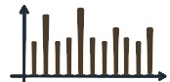

Key Idea of CLIP
Two people relax at a beach under a tree, enjoying a serene ocean view.
EMBEDDING 1
(must be)
VERY
SIMILAR
→ HIGH
EMBEDDING 2

Slide 3

Key Idea of Text to Image Generation
Two people relax at a beach under a tree, enjoying a serene ocean view.
EMBEDDING 1
(must be)
VERY
SIMILAR
→ HIGH
EMBEDDING 2

Slide 4
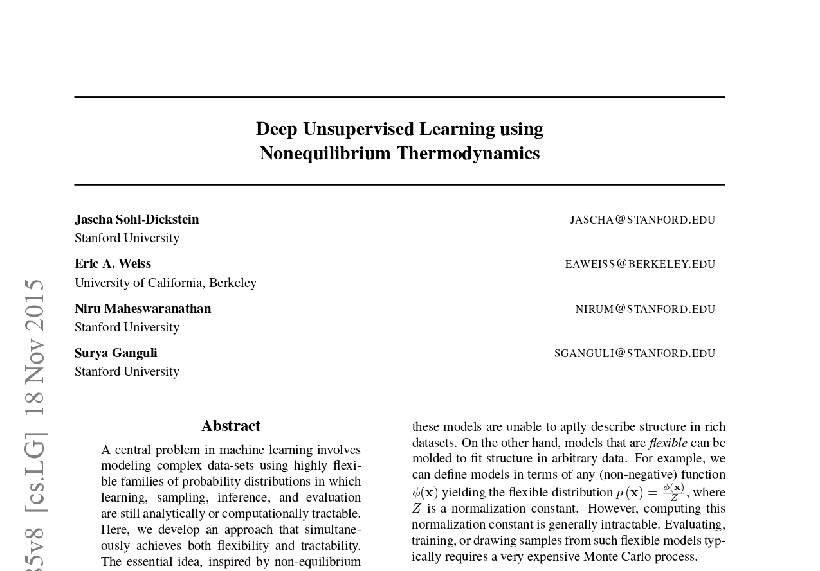

Slide 5
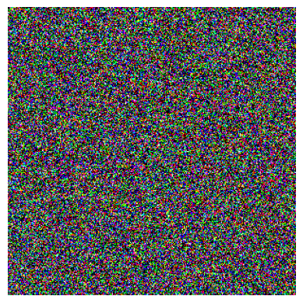
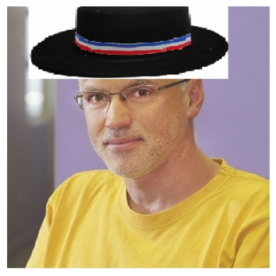
Image Generation – How to generate an image from noise?

Slide 6
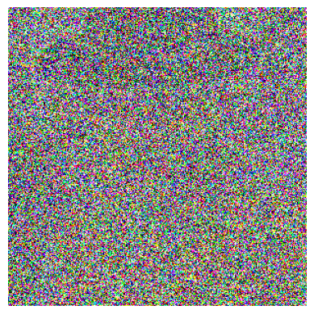
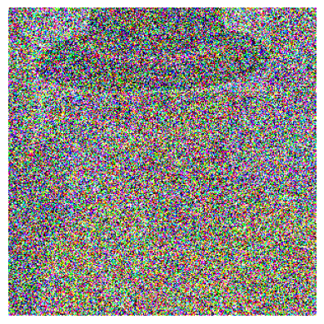
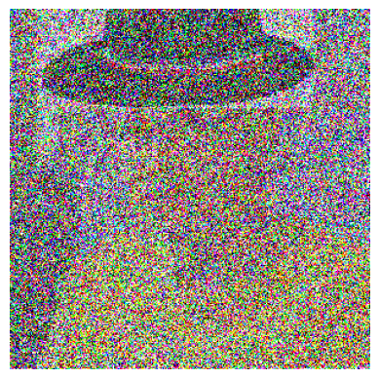
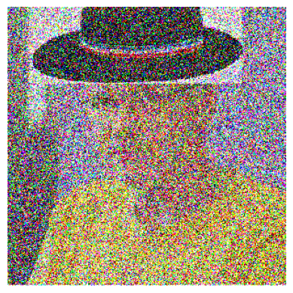
Image Generation – From Image to Noise

Slide 7
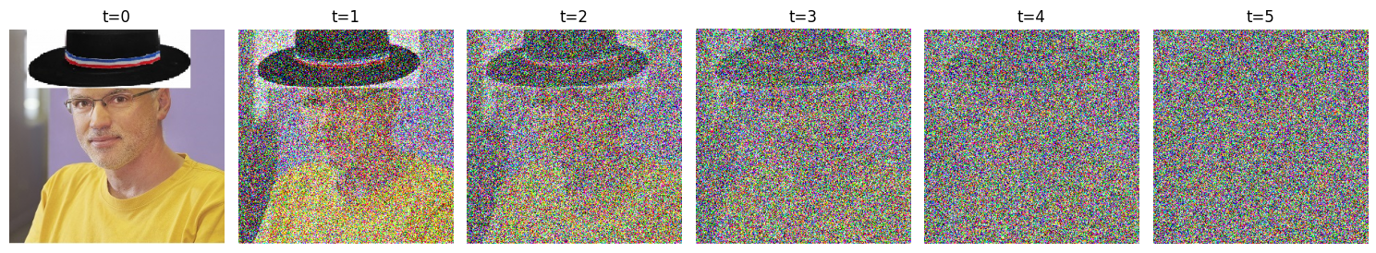
Image Generation – Idea

Slide 8
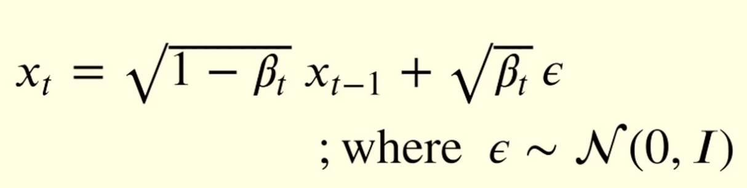
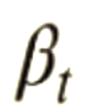
Image Generation – Idea
x₀
x₁
x₂
x₃
x₄
x₅
noise
Amount of Gaussian noise added at timestep t

Slide 9
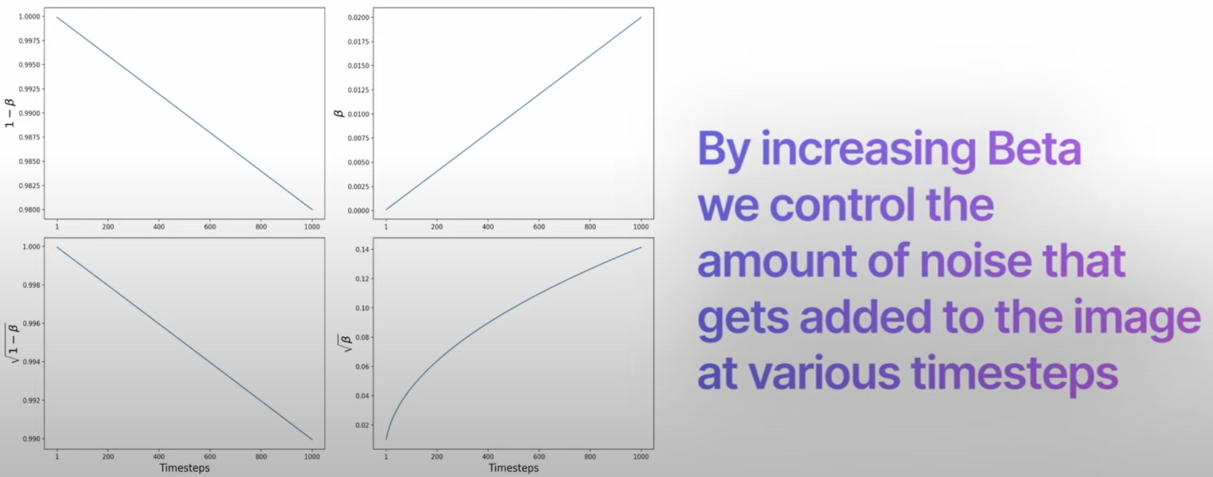
Amount of Gaussian noise added at timestep t

Slide 10
Image Generation – Idea
x₀
x₁
x₂
x₃
x₄
x₅
noise
Amount of Gaussian noise added at timestep t

Slide 11
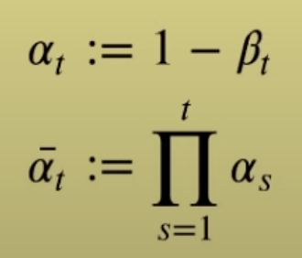

Image Generation – Idea
x₀
x₁
x₂
x₃
x₄
x₅

Slide 12
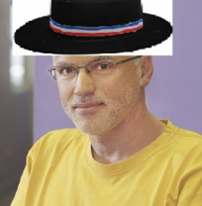
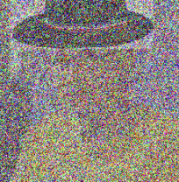
Image Generation – Idea
t = 2

Slide 13
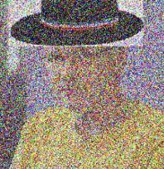
Image Generation – Idea
t = 1

Slide 14

Image Generation – Idea
t = 4

Slide 15
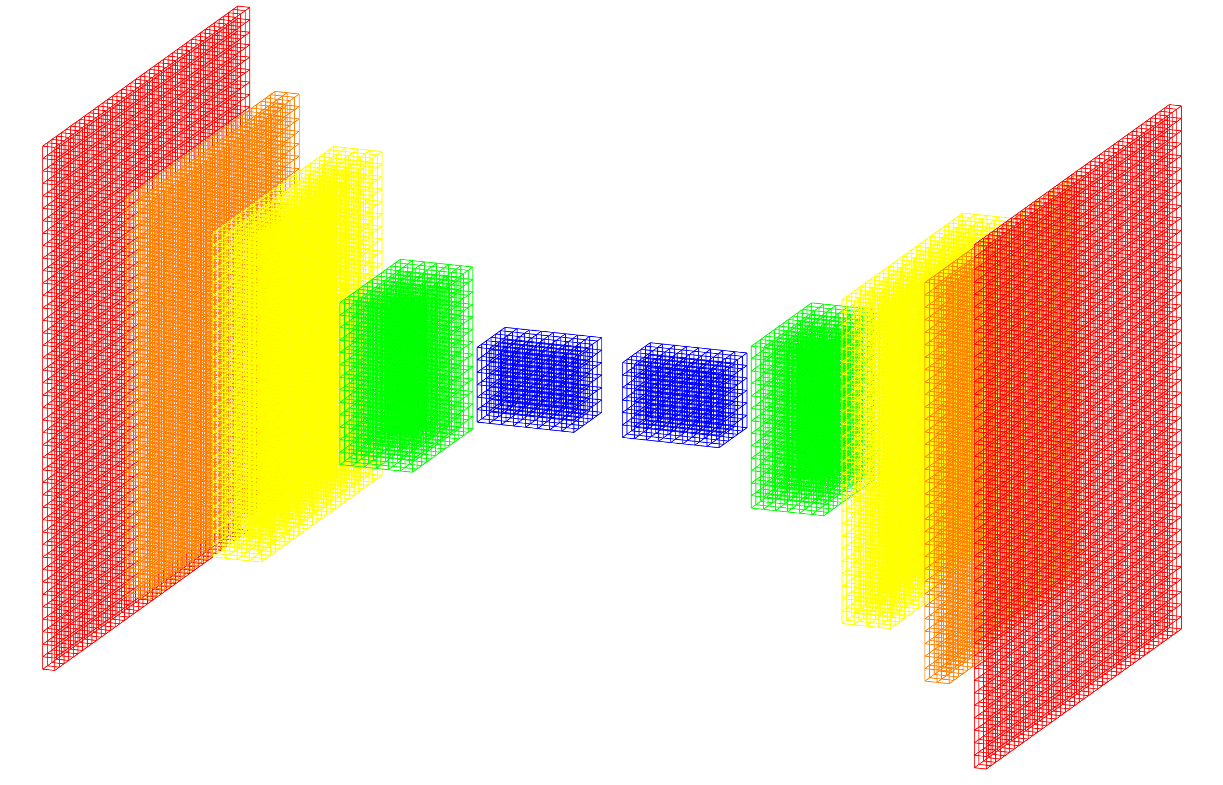
Image Generation – Idea : UNet for noise estimation
Image + noise
noise
original image

Slide 16
Image Generation – Idea : UNet for noise estimation
Image + noise
x_{t}
noise
t
using positional
encoding

Slide 17
Key Aspects

Slide 18
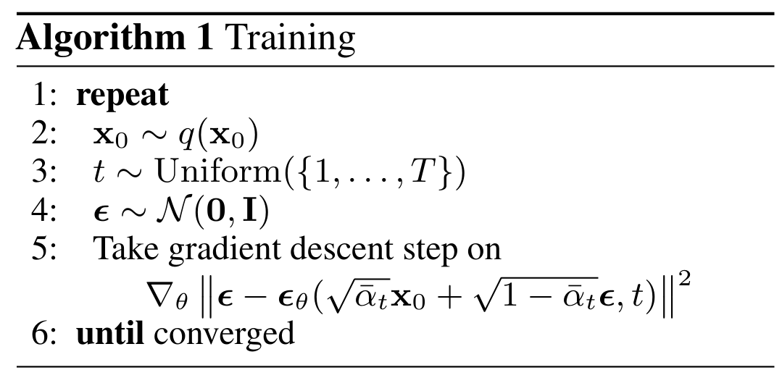
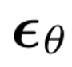
Training
Select image
Choose random t
Gaussian noise
Predict noise
and optimize using gradient descent relative to actual noise t

Slide 19
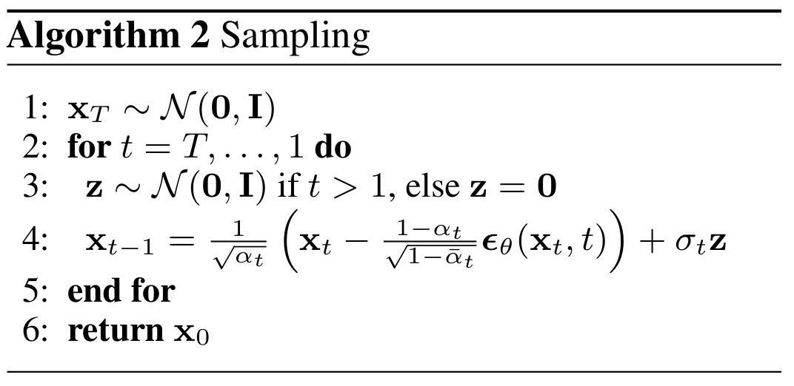

Testing: Reverse diffusion
Random noise
Radom noise for t>1
Predict noise and calculate difference to predict image
Predicted noise using UNet

Slide 20
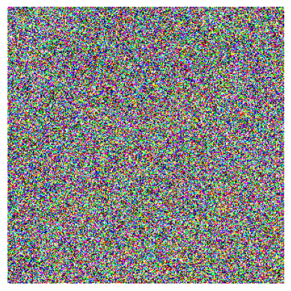
Image Generation – Idea
Example with two iteration.
In practice, we use approx. 1000 iterations

Slide 21
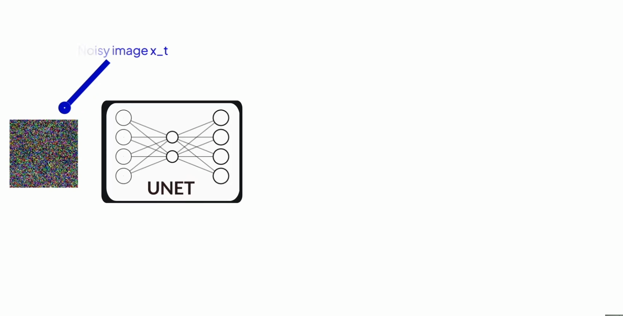
Image Generation – Idea
© https://youtu.be/w8YQcEd77_o

Slide 22
Image Generation – Idea : UNet for noise estimation
Image + noise
x_{t}
noise
t
using positional
encoding

Slide 23
How to include “t” in the Unet?

Slide 24
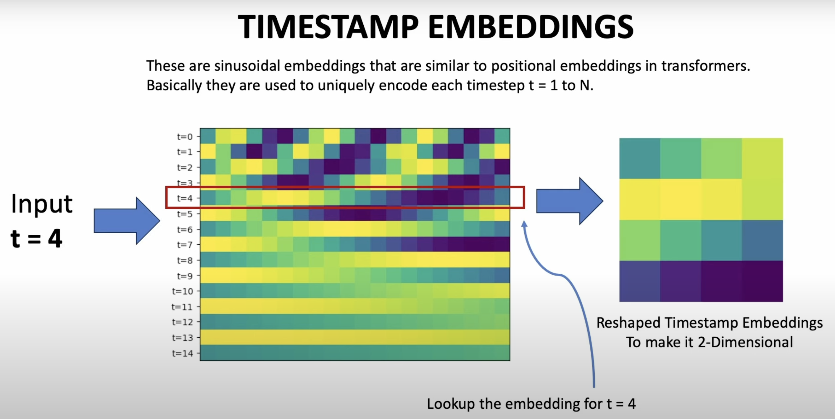
© https://youtu.be/w8YQcEd77_o

Slide 25
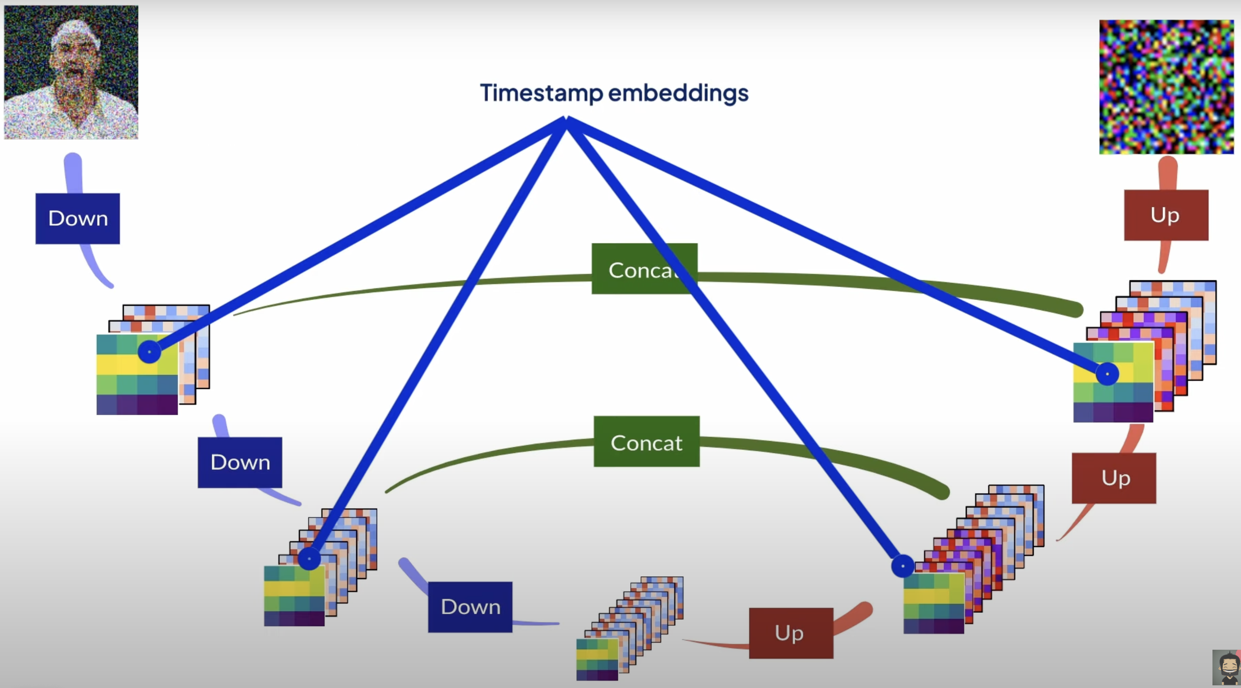

© https://youtu.be/w8YQcEd77_o

Slide 26

How to include text in the UNet to generate images?
EMBEDDING
“Man screaming”
RESHAPE

Slide 27
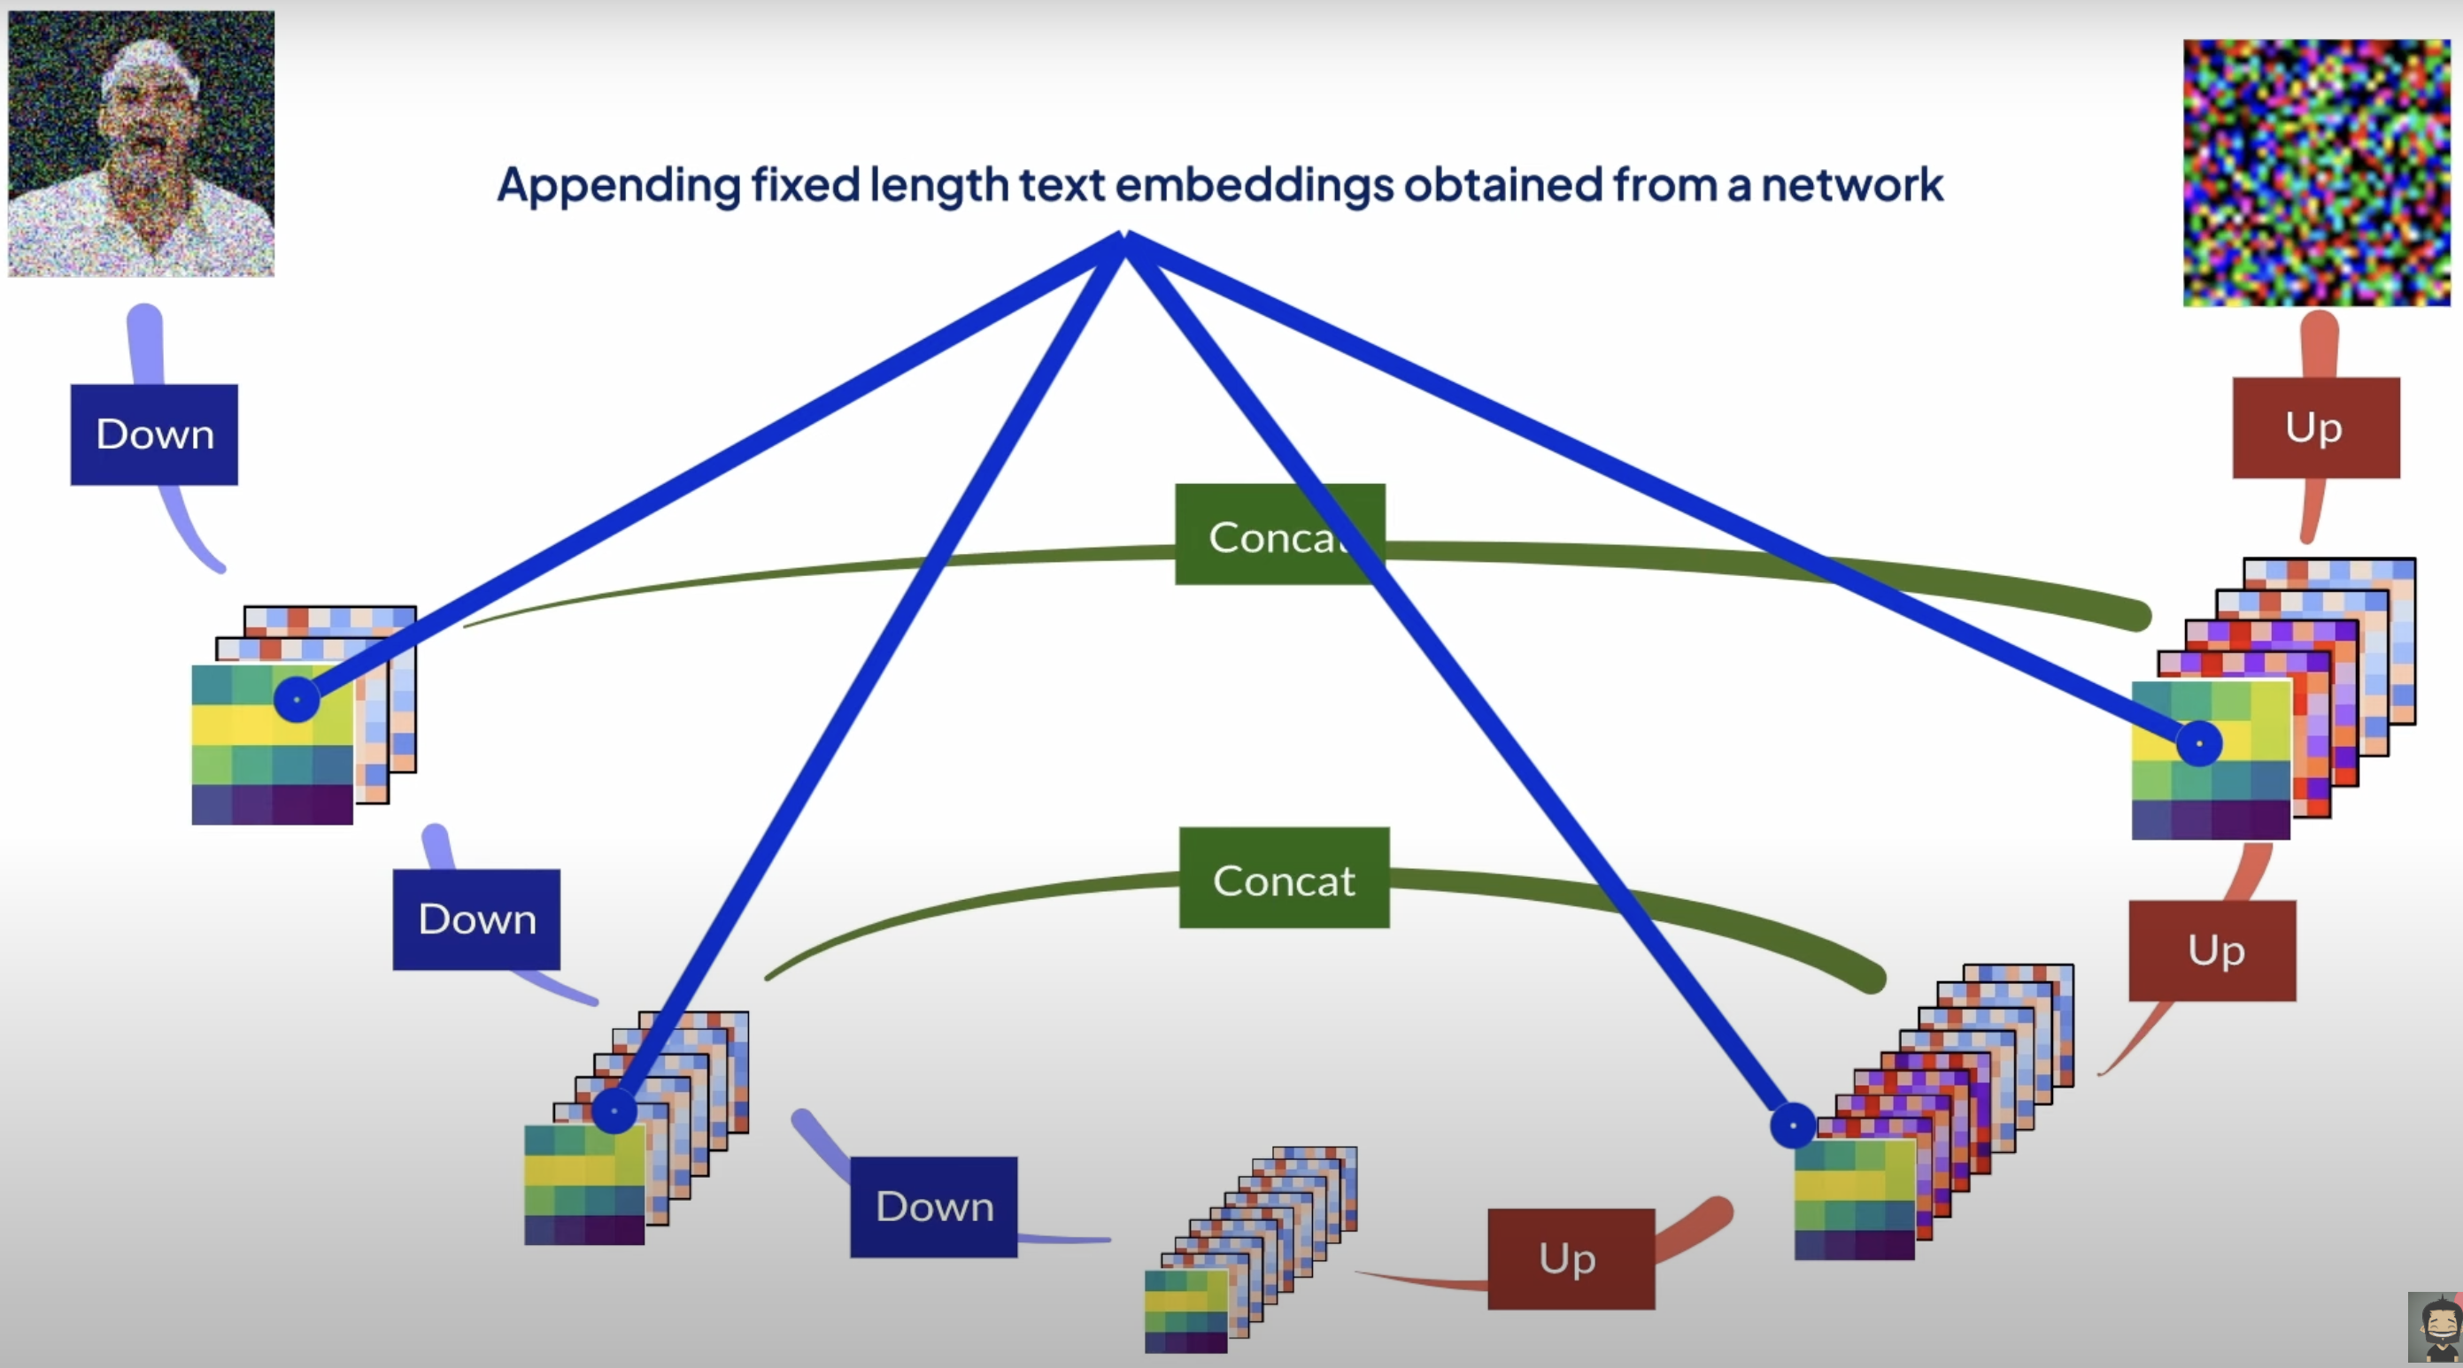
© https://youtu.be/w8YQcEd77_o

Slide 28
How to include text in the Unet to generate images?
A better ideal with Attention

Slide 29
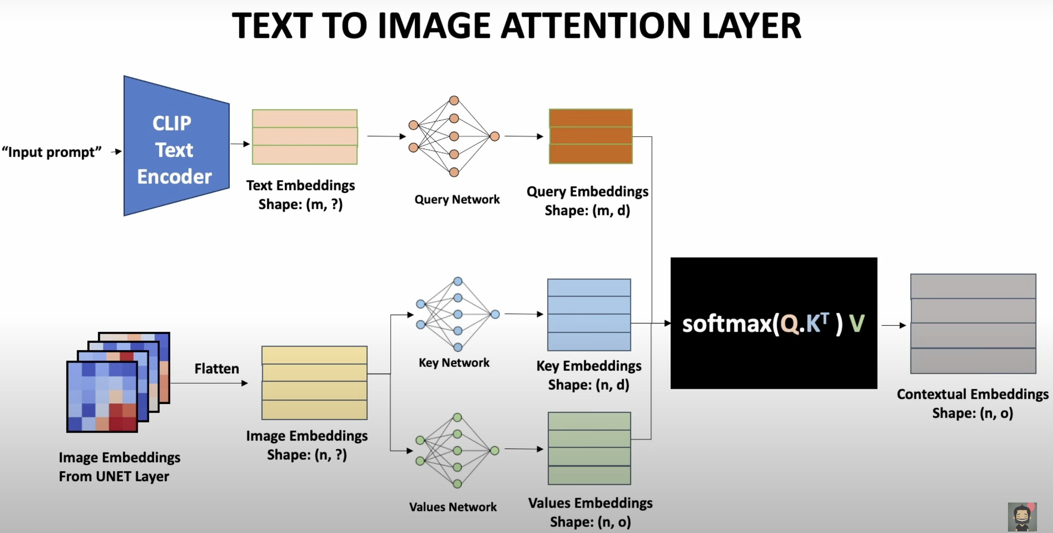
© https://youtu.be/w8YQcEd77_o

Slide 30
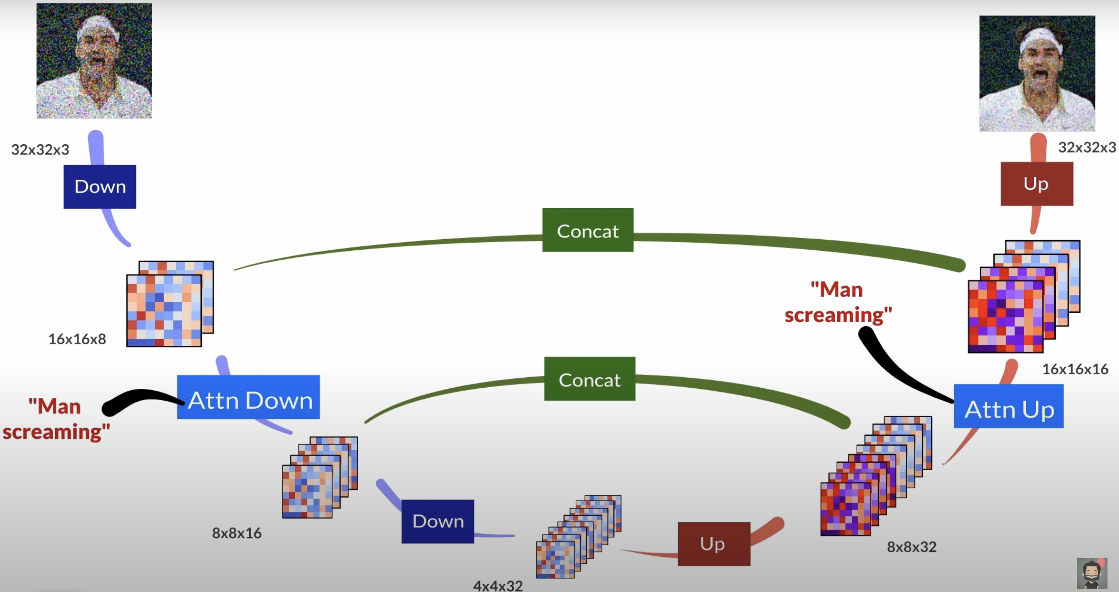
© https://youtu.be/w8YQcEd77_o

Slide 31
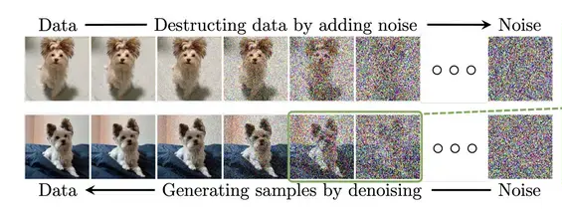
https://www.superannotate.com/blog/diffusion-models

Slide 32
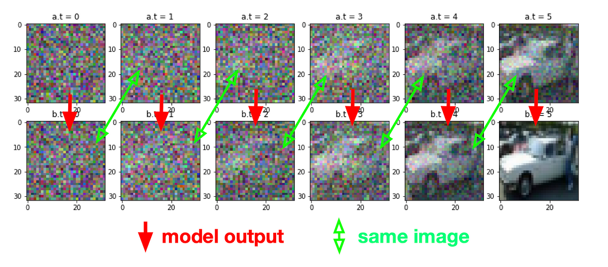
https://tree.rocks/make-diffusion-model-from-scratch-easy-way-to-implement-quick-diffusion-model-e60d18fd0f2e

Slide 33
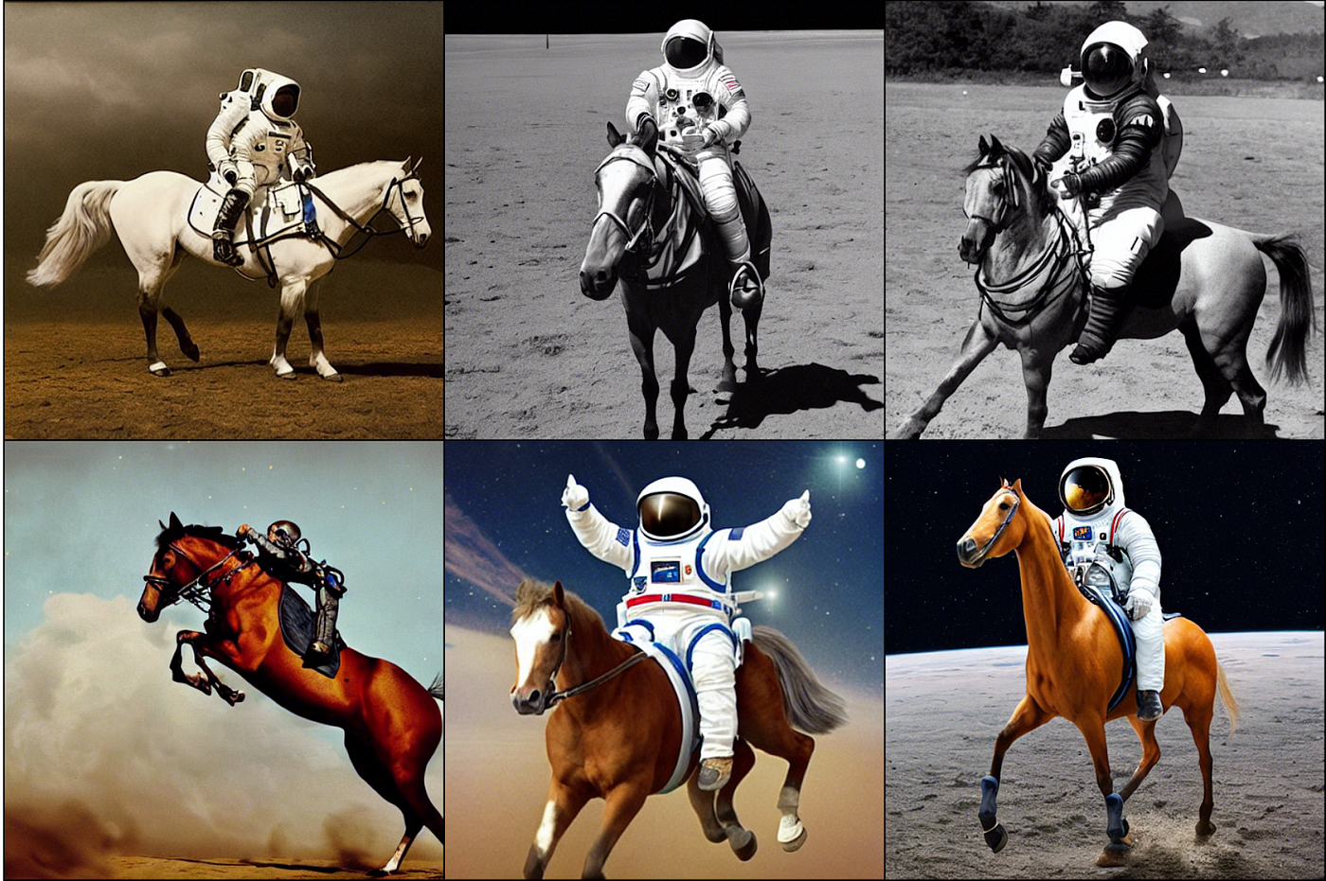
Prompt: a photograph of an astronaut riding a horse
https://klaviyo.tech/trying-to-understand-stable-diffusion-ea55eefca798

Slide 34
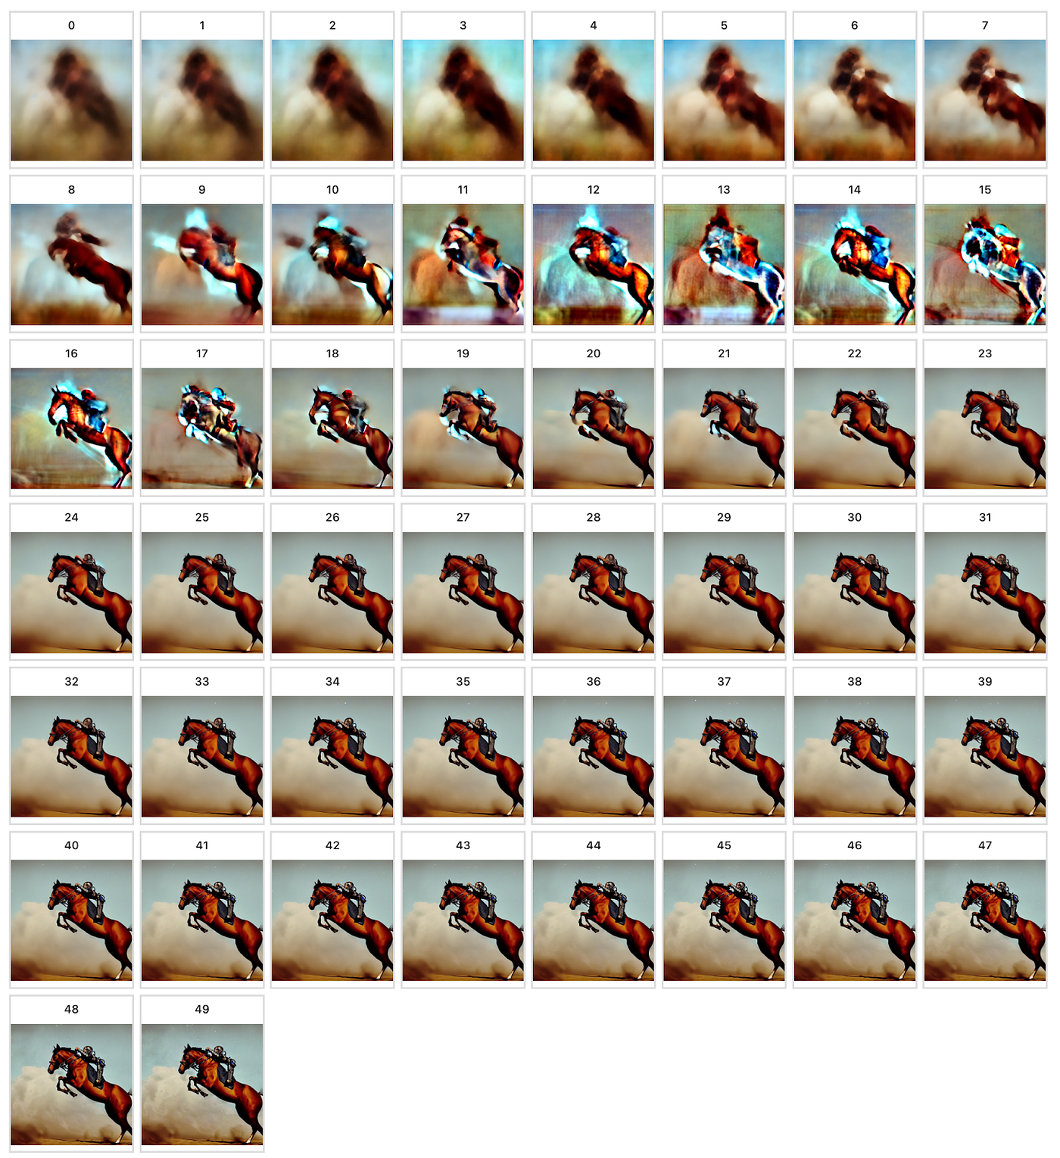
Prompt: a photograph of an astronaut riding a horse

